Slide 1



CLOUD COMPUTING
MEDIA STREAMING WITH
IBM CLOUD STREAMING
by: V. Jeevan Prakash

Slide 2
Project Description:
Creating a multimedia streaming application using IBM Cloud Video Streaming that offers an enhanced user experience by incorporating advanced features and customization options.
The project involves creating a virtual cinema platform using IBM Cloud Video Streaming. The objective is to build a platform where users can upload and stream movies and videos on-demand.
This project encompasses defining the virtual cinema platform, designing the user interface, integrating IBM Cloud Video Streaming services, enabling on-demand video playback, and ensuring a seamless and immersive cinematic experience for both content creators and viewers.

Slide 3
Design Thinking:
Platform Definition: A virtual cinema platform is a digital platform designed to replicate the cinema experience by allowing users to access and stream movies, documentaries, and other video content from the comfort of their homes.
User Interface Design: Designing an intuitive and user-friendly interface for a virtual cinema platform is crucial to provide users with a seamless experience when navigating, searching, and watching videos.
Video Upload: Enabling users to upload movies and videos to your virtual cinema platform involves creating a user-friendly and secure content submission process.
Streaming Integration: Integrating IBM Cloud Video Streaming services into your virtual cinema platform will help ensure smooth video playback and streaming.
5. User Experience: To provide a seamless and immersive movie-watching experience with high-quality video playback on your virtual cinema platform, you need to pay attention to several key aspects, including the video content itself, the video player, and the user interface.

Slide 4
Key Features and Components:
User Authentication and Authorization
Live Streaming
Video On-Demand (VOD)
Customizable Video Player
Interactive Features
Analytics Dashboard
Monetization Options
Content Management
Notifications
Security Measures

Slide 5
IBM Cloud Video Streaming, which is now part of IBM Watson Media, offers various use cases and applications across different industries.
1. Live Broadcasting and Webcasting
2. Education and E-Learning
3. Entertainment and Media
4. Corporate Communications
5. Healthcare
6. Gaming and Esports
7. Government and Public Sector.
8. Retail and E-Commerce
9. Sports and Fitness
10. Conferences and Trade Shows
11. Content Monetization
12. Security and Surveillance
13. Research and Development
14. Customer Support
15. Product Demonstrations

Slide 6
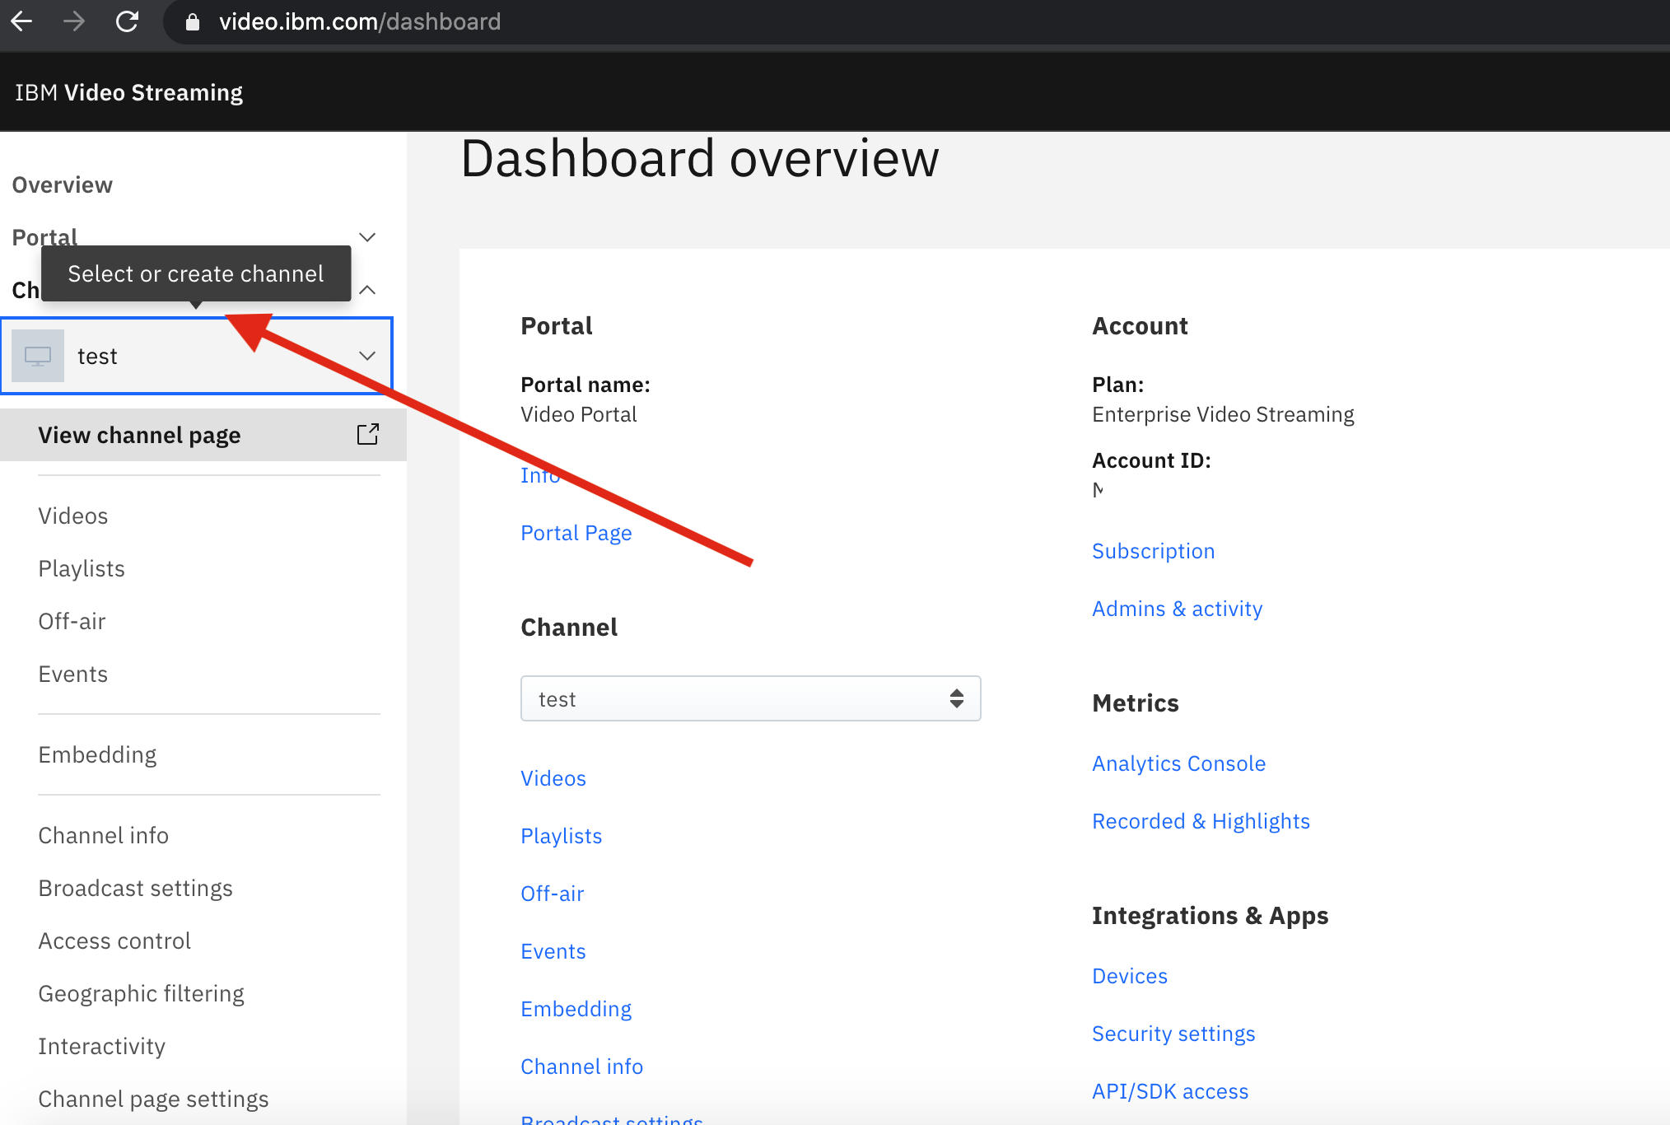
Steps for Creating Media Streaming &
Working Principles
Step 1: Creating a streaming channel by using IBM cloud service.
Step 2: Prepare your media content for streaming, ensure that content is in a compatible format.
STREAMING VIDEO TECHNOLOGIES:
CONVERTING ANALOG TO VIDEO SIGNALS AND COMPRESS THE DATA
DIGITAL VIDEO DEVICES THAT CAN CAPTURE IMAGE AND TRANSER TO LA COMPUTER.
Streaming audio technologies relies on:
Sound sequences
Compression scheme

Slide 7
AUDIO FORMAT:
MICROSOFT WINDOWS MEDIA FORMATS
.AVI, .ASF,.ASX,.RMI,.WAV
MOVING PICTURE EXPERTS GROUP(MPEG)
.MP3
MUSICAL INSTRUMENTS DIGITAL INTERFACE(MIDI)
.MID,.RMI
APPLE QUICK TIME MACINTOSH AIFF RESOURCE
.QT,.AIF,.AIFC,.AIFF,.MOV
UNIX FORMATS
.AU,.SND

Slide 8
VIDEO FORMAT AVI & ASF:
DEVELOPED BY MICROSOFT
AVI (AUDIO VIDEO INRELEAVED)
-LIMITED TO 320X240 RESOLUTION
-30 FRAMES PER SECOND
ASF (ADVANCED STREAMING FORMAT)
-HAS BEEN SUBMITTED TO ISO FO STANDARDIZATION
-EXPECTED TO REPLACE AVI FORMAT

Slide 9

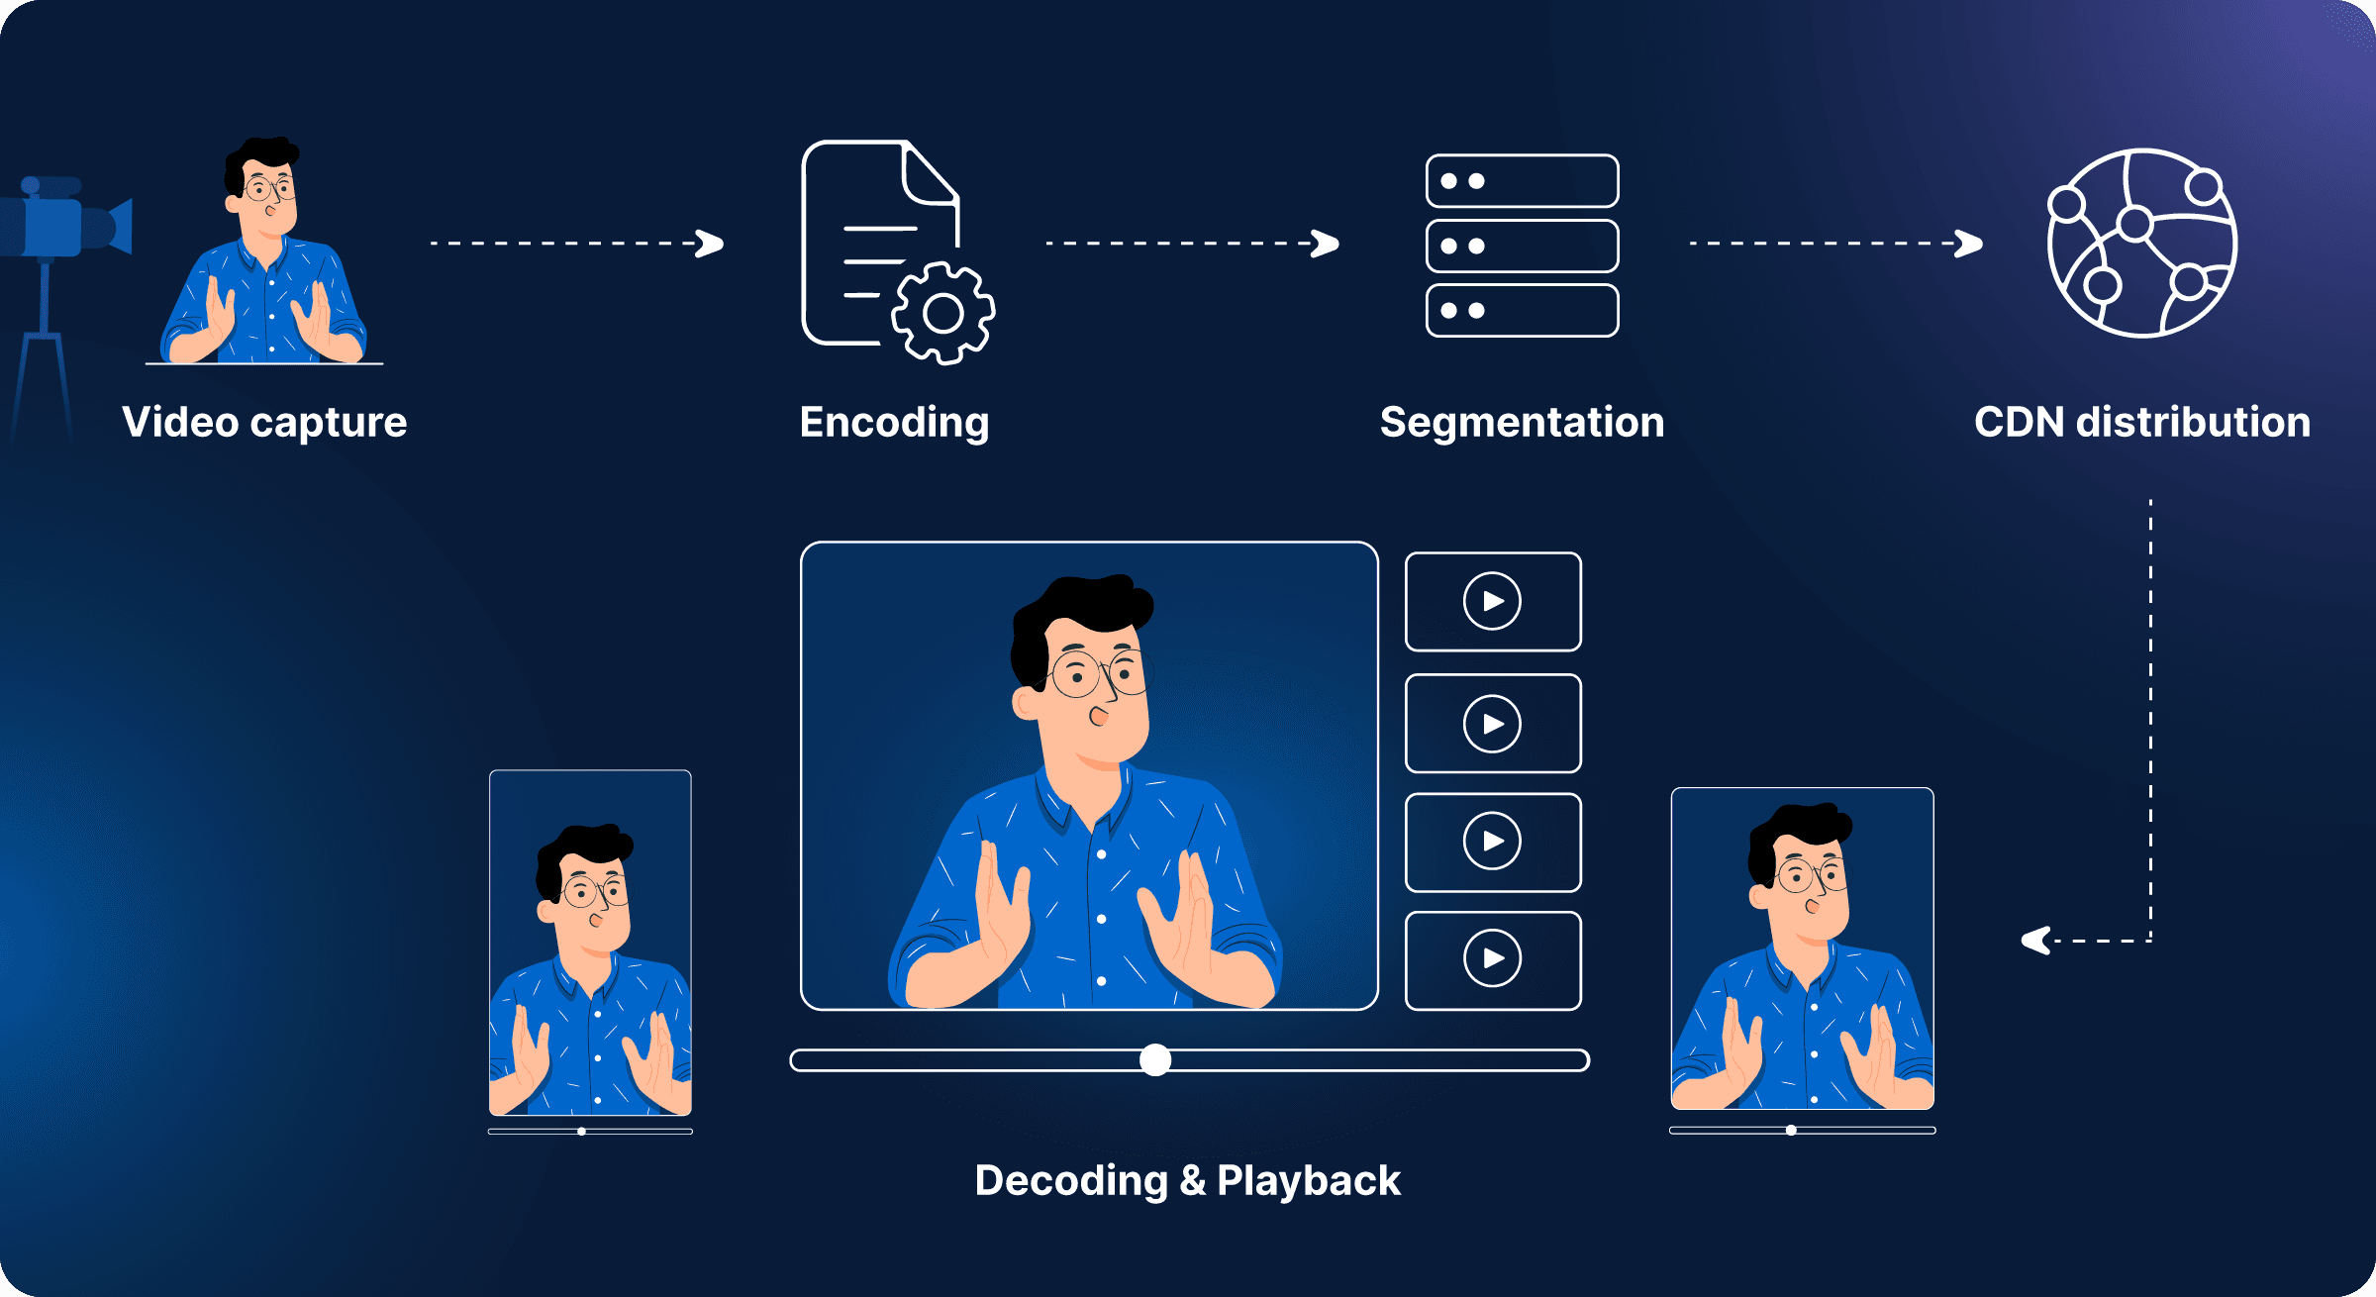
Step 3: Whether the streaming is live or on-demand.
Step 4: Setup encoding and transcoding to ensure that media content is delivered.

Slide 10
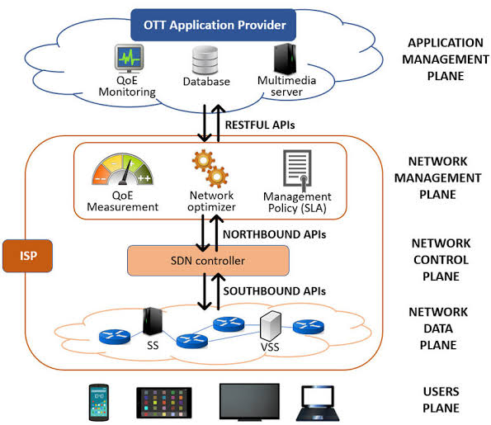
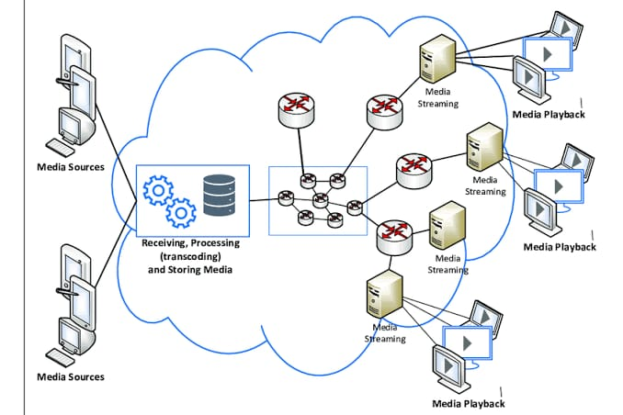
ARCHITECTURE:

Slide 11
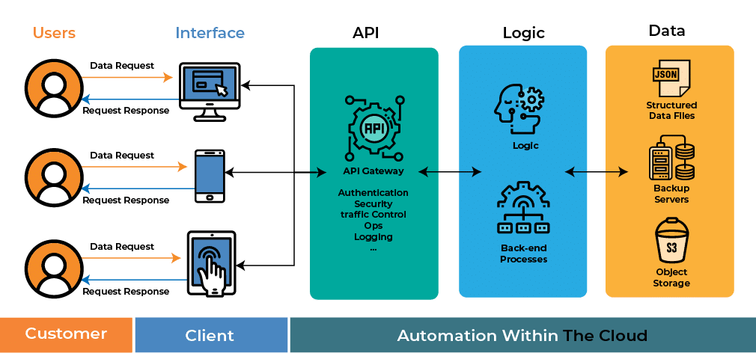
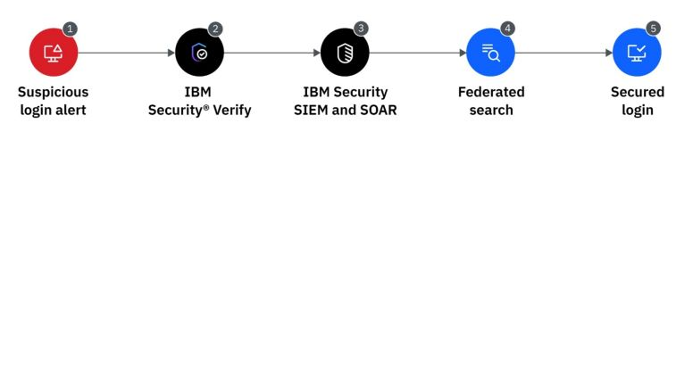
Step 5: Integrate with streaming APIs and SDK into application or website.
Step 6: Implementing required security features.

Slide 12
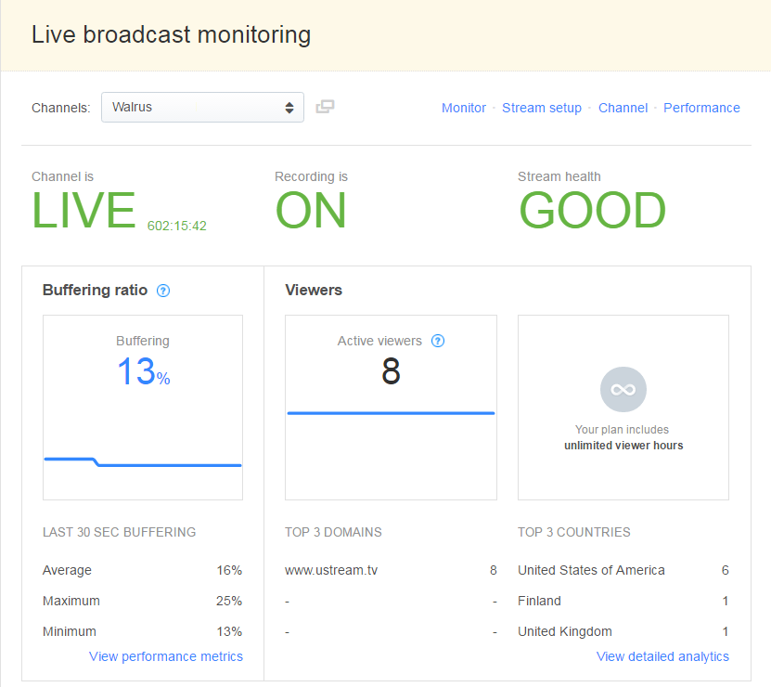
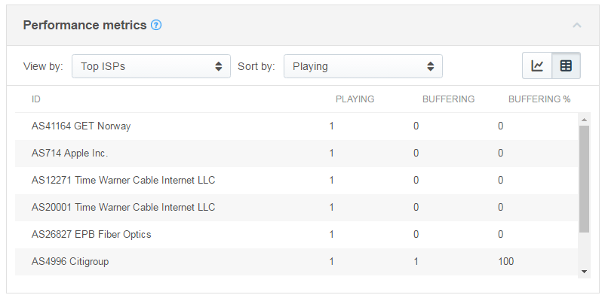
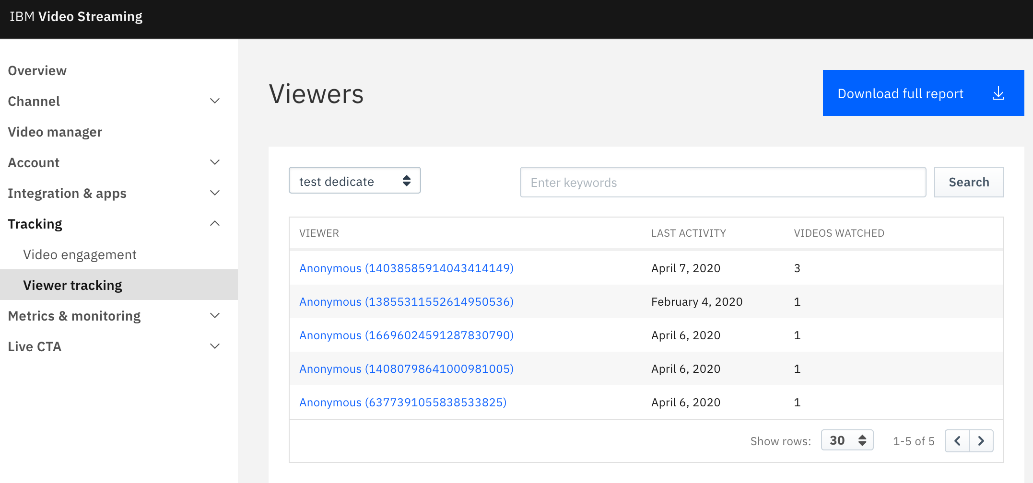
Step 7: Set up monitoring and analytics to track the performance of the streaming service.
Step 8: Testing the streaming setup.

Slide 13
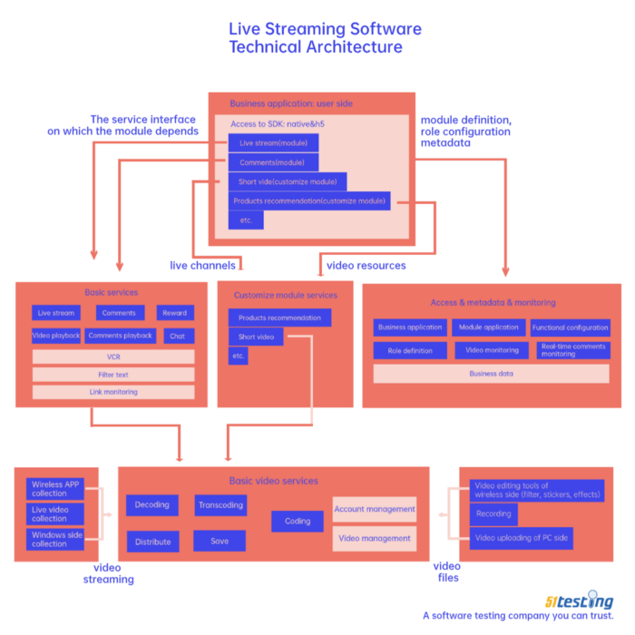
Step 9: Accommodate viewers for the streaming service.
Step 10: Provide user guidelines, once again setup and test streaming project and regularly monitor and maintain streaming service.

Slide 14
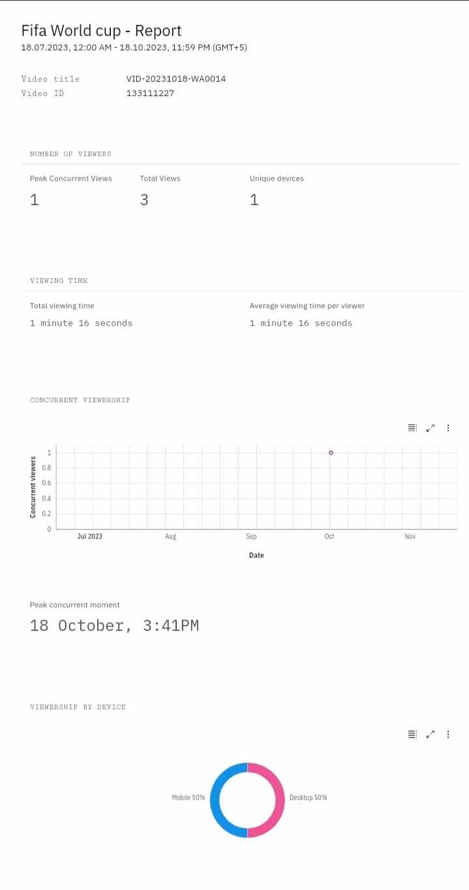
Creation Report

Slide 16
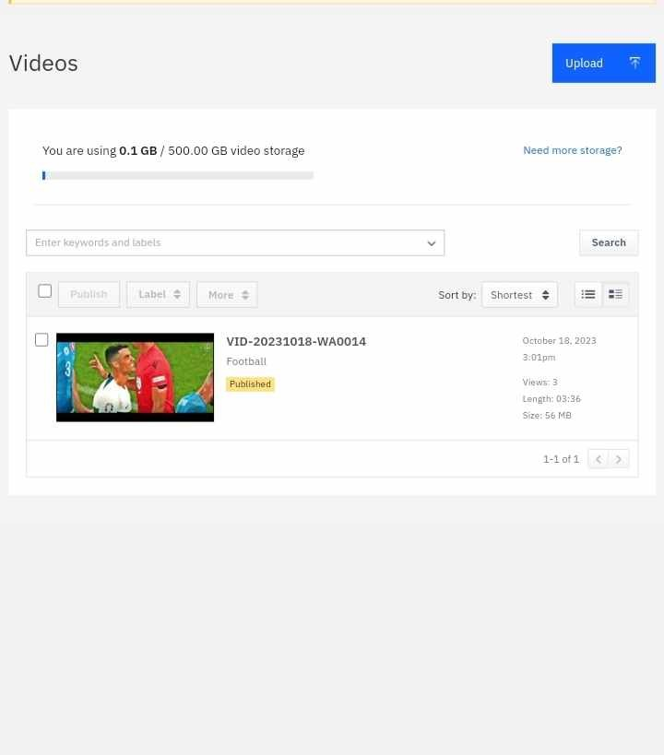

Slide 17
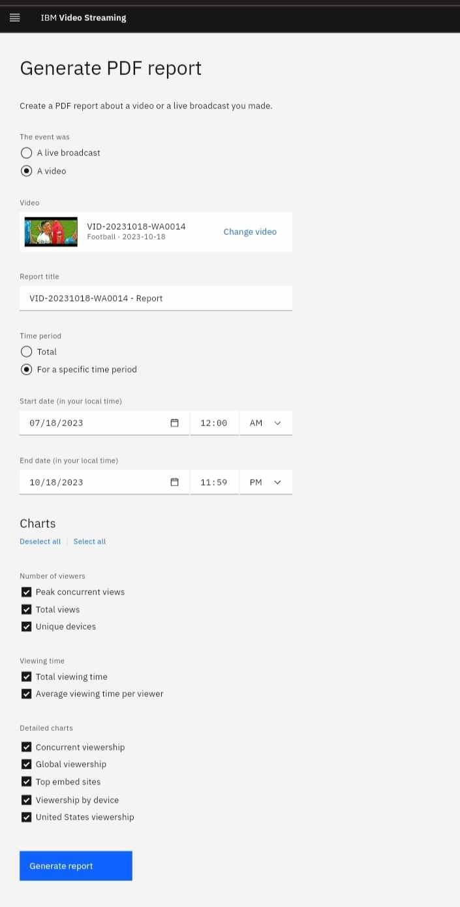

Slide 19
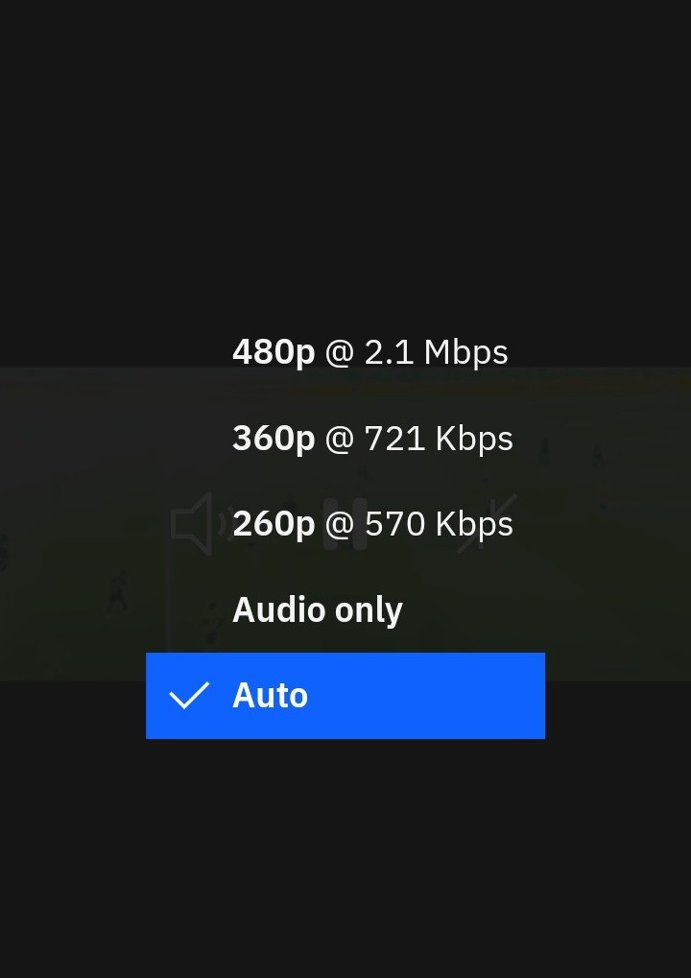

Slide 20
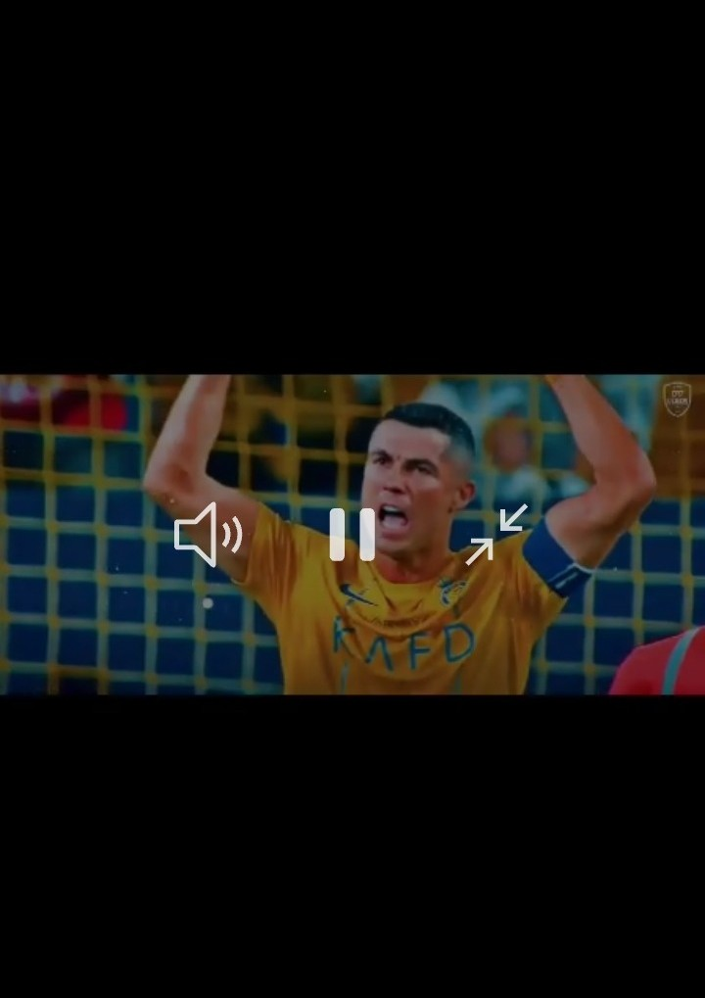

Slide 21
Conclusion
the development of a cloud-based live event streaming platform utilizing IBM Cloud Streaming services offers a compelling solution for event organizers and viewers alike.
This project combines cutting-edge technology with user-centric features to create an efficient and engaging platform.
By focusing on user registration, event management, secure and high-quality streaming, monetization, user experience, analytics, security, and mobile access, this platform addresses the diverse needs of both content creators and consumers.

